Slide 1

Self-Supervised Learning for Betel Leaf Classification
A Comparative Study of Supervised and SSL Approaches
GROUP 06

Slide 2

Introduction
Title text addition
Betel leaf is widely used for cultural, medicinal, and commercial purposes
Quality assessment depends on visual inspection
Manual inspection is:
Time-consuming
Subjective
Not scalable
The user can demonstrate on a projector or computer, or print the presentation and make it film

Slide 3
Problem Statement
Title text addition
Deep learning models require large labeled datasets
In agriculture:
Labeling is expensive
Requires expert knowledge
Limited labeled data reduces model performance
The user can demonstrate on a projector or computer, or print the presentation and make it film

Slide 4
Motivation
Title text addition
Unlabeled agricultural images are easy to collect
Self-Supervised Learning (SSL):
Learns features without labels
Improves performance in low-label scenarios
The user can demonstrate on a projector or computer, or print the presentation and make it film

Slide 5
Dataset – PriBeL
Title text addition
Public betel leaf image dataset
~885 RGB images
3 classes:
Healthy
Dried
Diseased
The user can demonstrate on a projector or computer, or print the presentation and make it film

Slide 6
Data Characteristics
Title text addition
Balanced class distribution
Mostly square-shaped images
Variations in:
Lighting
Background
Leaf orientation
The user can demonstrate on a projector or computer, or print the presentation and make it film

Slide 7
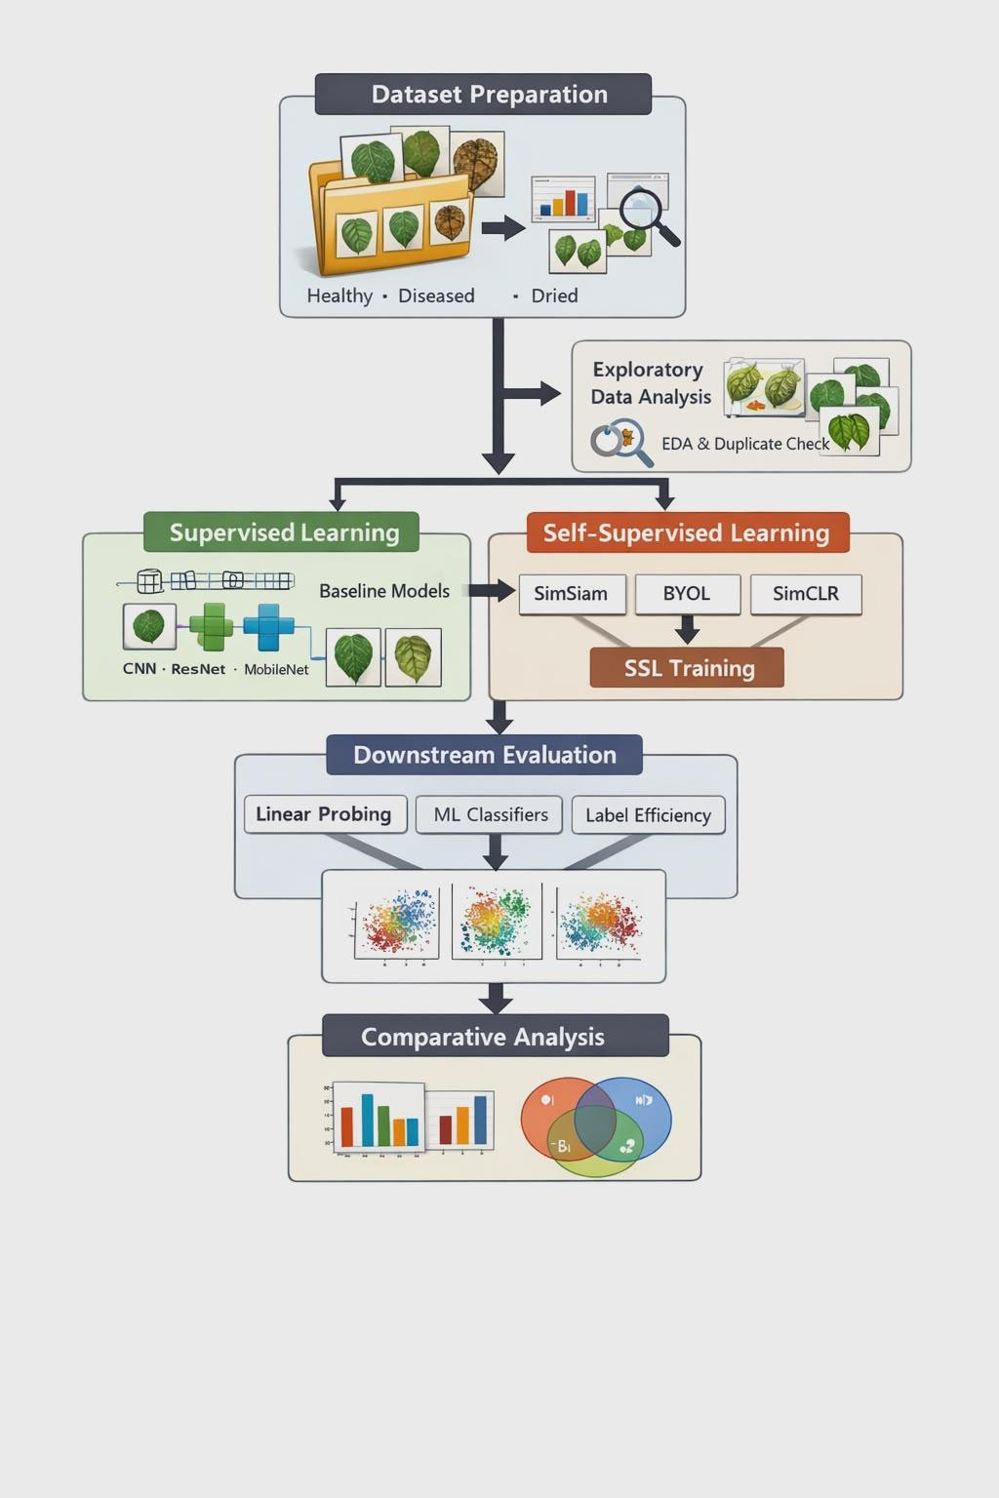
Methodology
Title text addition
The user can demonstrate on a projector or computer, or print the presentation and make it film

Slide 8

Supervised Learning Models
Baseline models used:
Custom CNN
MobileNet
VGG16
ResNet50
EfficientNet-B0
Training with multiple train-test splits (90:10 → 10:90)

Slide 9
Self-Supervised Learning Models
SimCLR (contrastive learning)
BYOL (non-contrastive, momentum-based)
SimSiam (simple siamese architecture)
A contrastive self-supervised method that learns representations by pulling together augmented views of the same image and pushing apart different images.
A non-contrastive self-supervised method that learns representations using an online and a target network without negative samples.
A simple non-contrastive self-supervised method that learns representations using a Siamese network with a stop-gradient mechanism.

Slide 10
Experimental Setup
Image size: 224 × 224
Learning rate: 0.0001
Frameworks: TensorFlow, PyTorch
Optimizer: Adam
Batch size: 32

Slide 11
Supervised Results
Deep pretrained models outperform shallow CNN
VGG16 performed well with lower computation cost
EfficientNet-B0 achieved highest accuracy:99.7%

Slide 12
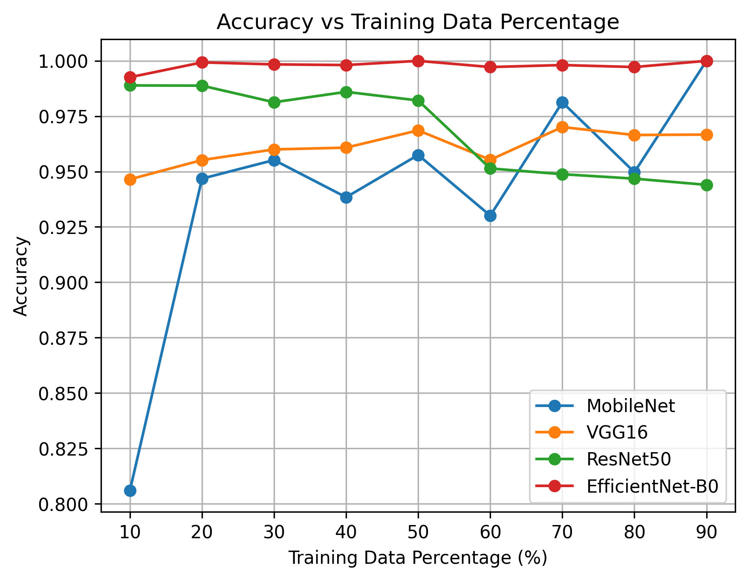
Accuracy vs Training Data
Observations:
MobileNet degrades quickly with less data
EfficientNet-B0 & ResNet50 remain stable
Deep models generalize better under limited data
Title text addition
The user can demonstrate on a projector or computer, or print the presentation and make it film

Slide 13
SSL Label Efficiency Results
Supervised models perform poorly with ≤10% labels
SSL models show:
Better low-label performance
Competitive results with full labels
BYOL showed the most consistent performance

Slide 14
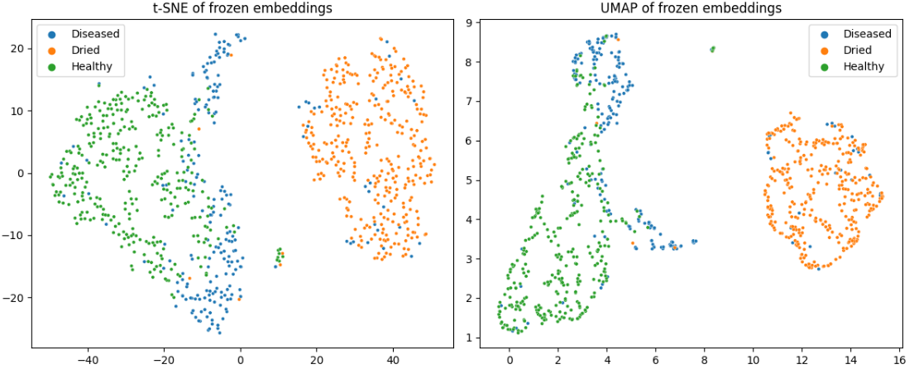
Feature Visualization (t-SNE & UMAP)
Figure:SimCLR

Slide 15
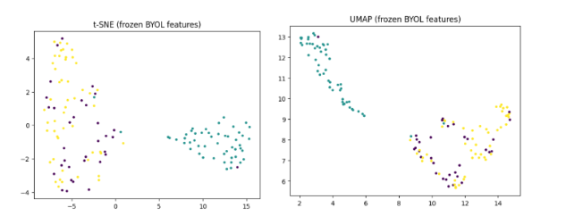
Feature Visualization (t-SNE & UMAP)
Figure:BYOL

Slide 16
Ablation Study Findings
BYOL
SimSiam
Most stable accuracy
Balanced Macro-F1 score
Lower discriminative power
SimCLR
Competitive but higher variance

Slide 17
Key Findings
1
2
3
4
Deep supervised models perform best with enough labels
SSL significantly improves low-label performance
BYOL is the most robust SSL method
SSL reduces dependency on manual annotation

Slide 18
Conclusion
EfficientNet-B0 achieved highest supervised accuracy
BYOL is ideal for agricultural datasets with label scarcity
SSL enhances representation learning without labels

Slide 19
Future Work
Larger and more diverse datasets
Real-time deployment on low-resource devices
Advanced SSL and semi-supervised techniques
Cross-dataset generalization studies

Slide 20
THANK YOU

